Slide 1


Direct Speech
Chapter 5: Indirect speech
Indirect Speech
I will buy a laptop for you.
Introductory statement
Speaker’s exact words
My father said, “I will buy a laptop for you.”
My father said (that) he would buy a laptop for me.
Comma
quotation marks

Slide 2
Follow these 5 steps to make indirect speech:
Define the type of the sentence (statement, question, command)
2. What tense is used in the introductory sentence?
3. Do you have to change the person (pronoun)?
4. Do you have to change (backshift) the tenses?
5. Do you have to change expressions of time and place?

Slide 3
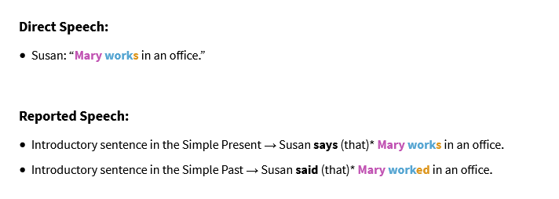
What tense is used in the introductory sentence?
Simple present Simple present
Simple past Backshift (change) tense

Slide 4
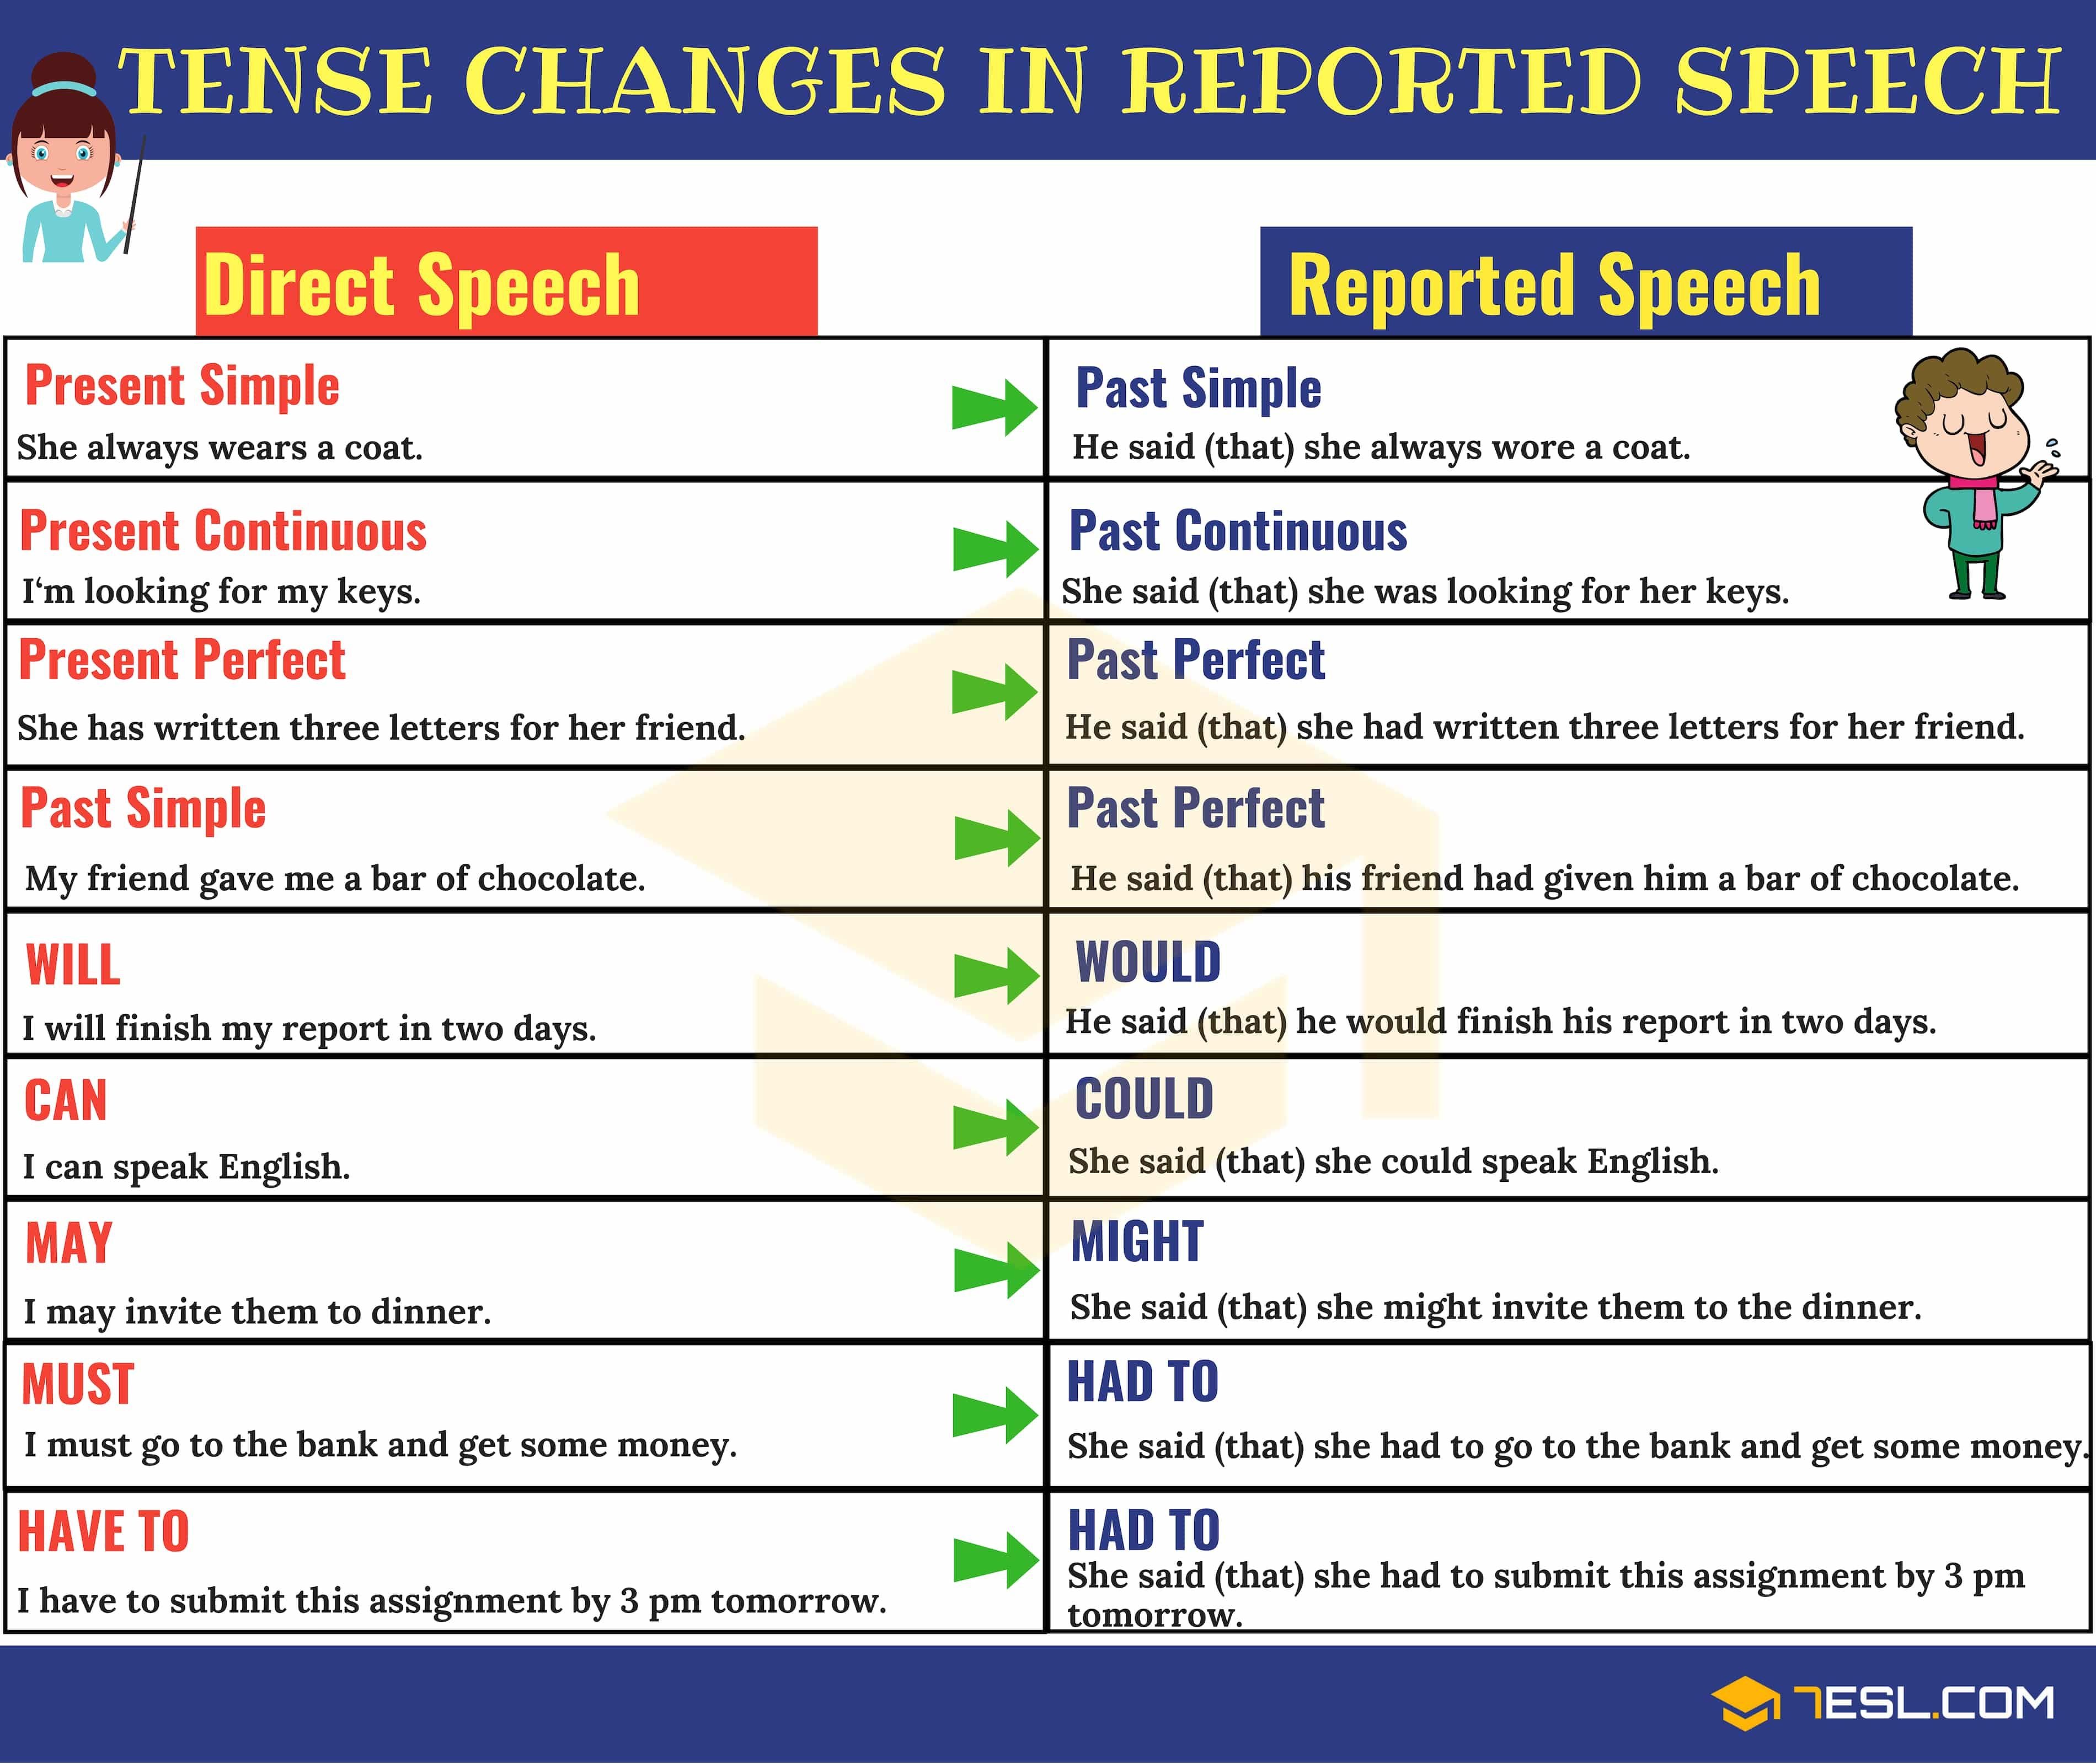

Slide 5
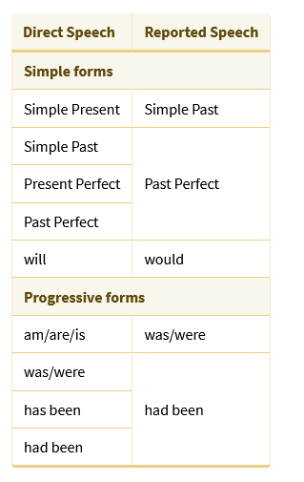
For details, please click on the following link:
https://www.englisch-hilfen.de/en/grammar/reported_statements.htm

Slide 6
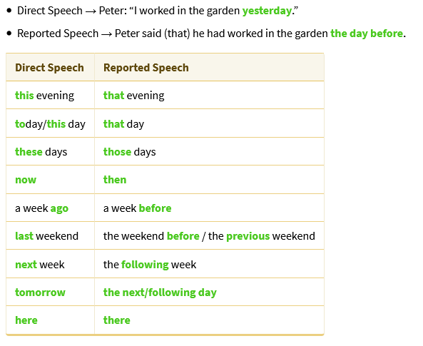
Conversion of expressions of time and place

Slide 7
What is Indirect Speech?
In order to report what someone has said, you can use either direct speech or indirect speech.
Direct Speech: In this type of reporting we mention speaker’s exact words and put them between two quotation marks right after an introductory verb and a comma:
Ehsan said, “I am going to watch movies.”
Indirect Speech: In this type of reporting, we don’t mention speaker’s exact words but we keep the exact meaning of the sentence. Because it is indirect, (1) the comma and quotation marks are removed, (2) a ‘that’ is added, and (3) the main verb and sometimes the subject in the indirect statement are changed:
Ehsan said that he was going to watch movies.

Slide 8
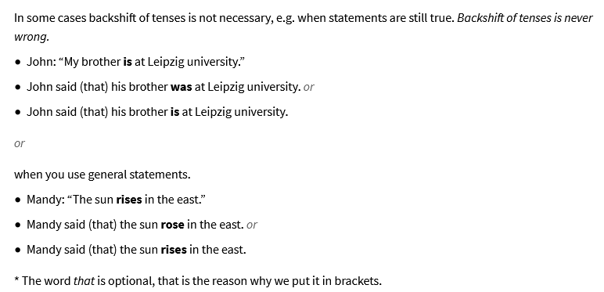
In some cases backshift of tenses is not necessary, e.g. when statements are still true. Backshift of tenses is never wrong

Slide 9
Questions: Yes/No Question
Direct Question | Reported Question
Have you ever been to Tabriz? | My friend asked me if I had ever been to Tabriz.
Are you living here? | Ali asked me if I was living there.
Do you like chocolate? | She asked me if I liked chocolate.

Slide 10
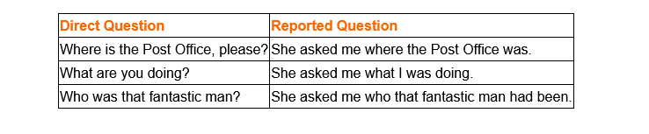
Wh- Question
https://www.perfect-english-grammar.com/reported-speech.html

Slide 11

Commands and requests:
My father: “Turn off the air conditioner.”
My father asked me to turn off the air conditioner.
My father: “Do not turn on the air conditioner.”
My father asked me not to turn on the air conditioner.

Slide 12
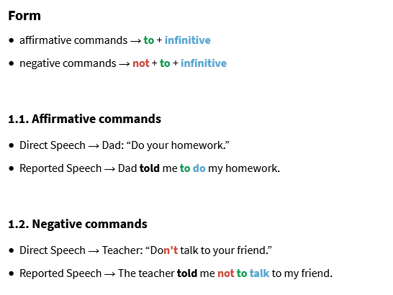

Slide 13
Supplementary notes:
Note 1: The infinitive in the indirect statement is never changed. The pronouns and possessives change to the second or third persons except when the speaker is reporting his/her own words.
Note 2: When the introductory verb is in the simple present tense, no change would be made in the verb(s) of the reporting statement:
Direct speech: Dr. Kaveh says, “IT will continue to be a hot topic in research.”
Indirect speech: Dr. Kaveh says (that) IT will continue to be a hot topic in research.
Note 3: For questions which begin with an auxiliary (did, do, & does), the auxiliary is replaced with ‘if’ in indirect speech. In such a case, ‘that’ is no longer used.
Paria asked, “Did you send your project?”
Paria asked if I had sent my project.

Slide 14

“Always remember that you are absolutely unique, just like everyone else!”

